Slide 1
Using Data to Improve the Behavioral Health and Justice Interface:
MISSION-Criminal Justice Services
Debra A. Pinals, M.D.
Director, Program in Law, Psychiatry, and Ethics
Clinical Professor of Psychiatry
University of MICHIGAN
Medical Director for Behavioral health and forensic programs
Michigan department of health and human services

Slide 2
Model Development
Original Developer: D. Smelson, Psy. D.
Originally designed for veterans facing homelessness
Developed out of federal granting to state and academic partners
Maintaining Independence and Sobriety through Systems Integration, Outreach, and Networking: Criminal Justice Edition (www.missionmodel.org)

Slide 3
MISSION: Criminal Justice: combining a BH and CJ Framework
Systems Level (Sequential Intercept Model)
Reduce penetration of persons with mental illness into CJ system/Reduce recidivism | Identify and Link individuals to community-based mental health treatment | Improve mental health outcomes | Improve public safety
Assessment Level (RNR)
Match level of treatment to the level of risk to re-offend | Identify criminogenic needs and use these to inform treatment | Maximize engagement by understanding responsivity of the individual to treatment interventions and the ability of providers to address the risk factors identified while still emphasizing traditional treatment focus
Intervention/Person Level (MISSION-CJ)
Provide direct treatment services to address co-occurring disorders with trauma-informed approaches that support recovery | Additional focus on criminogenic needs and responsivity to reduce recidivism; focus also on traditional treatments | Promote stable and successful living with positive daily activities and health and wellness, with explicit attention to the additional goal of decreased recidivism | Coordinate care, access to housing, employment supports and other services as needed

Slide 4
Combining evidence-based services into a comprehensive system of care
MISSION-CJ
Core Services
Risk-Need-Responsivity (RNR)
Support Services
Critical Time Intervention (CTI)
Vocational and Educational Support
Dual Recovery Therapy (DRT)
Trauma-Informed Care
Peer Support
-Critical Time Intervention (Susser et al, 2007)
-Dual Recovery Therapy (Ziedonis et al, 1997)
-Peer Support (Chinman et al, 2010)
-Vocational/Educational Support (Ellison et al, 2012)
-Trauma Informed Care (Najavits et al, 2011)
-Risk-Need-Responsivity (Blanchette & Brown, 2006; Ward, Mesler & Yates, 2007)
Notes:
MISSION-CJ is a flexible, time-limited, and
comprehensive treatment intervention rooted in the
Health Belief Model (Becker, 1974), targeting individuals
with mental illness and co-occurring substance use
disorders.

Slide 5
Healthcare coverage
Community Mental Health Services
Community Based Health Services
Psychiatric Hospital Care
Court-ordered services
Correctional Institutional Care
Emergency Room Care
Community Substance Use Services

Slide 6
Client Service Needs
Housing
Case Management
Educational and Vocational Support
Benefits
General Medical Care
Mental Health Services
Substance Abuse Treatment
Criminal Justice

Slide 7
MISSION: CJ Key Goals
Improve Clinical Outcomes and functioning
Maximize Community Tenure
Reduce Re-Arrest
Reduce Serious criminal activity
Prevent Incarceration (Reduce Jail Days)
Prevent Hospitalization
Identify and link individuals to comprehensive and effective community-based behavioral health care
Focus on trauma histories
Prevent Homelessness
Enhance public safety

Slide 8
MISSION CJ Materials
Additional Resources:
Fidelity Measure-Tracks the integration of the complex service structure
Consultation/Implementation Assistance- Available from the authors
Notes:
Fix formattting

Slide 9
Fidelity Measure
Evaluates Treatment Plan
Tracks DRT and Peer sessions attended
Determines if service needs were met
Examines location of services, community outreach efforts and barriers
Assesses service linkages and discharge planning

Slide 10
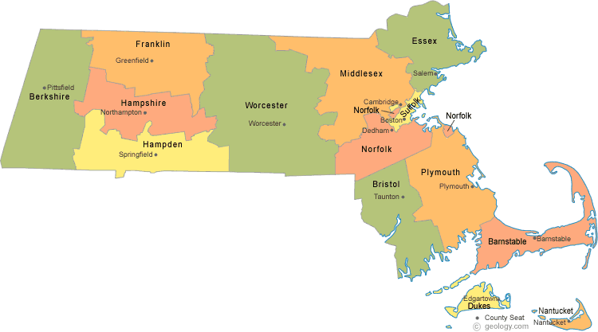
Previous and Current MISSION Project Sites: Massachusetts
MISSION-VET Model Development
Improving Outcomes for Homeless Veterans with Peer Support
HOUSED
WI-RAPS
CREW
CREST
FORWARD
VET Implementation
HUD VASH Implementation
CAPE
MASS-MISSION
RAPS
MISSION Model Types:
MISSION 1st Ed.
I-RAPS
MISSION 2nd Ed.: Homelessness
MISSION-CJ
MISSION-VET
Notes:
Improving Outcomes for Homeless Veterans with Peer Support: Bedford – MISSION-VET
MISSION-VET Model Development: Bedford – MISSION-VET
CREST: Springfield District Court, serves Hampden County – MISSION-CJ
WI-RAPS: Hampden County Sheriff’s Department & Western Massachusetts Regional Women's Correctional Center in Springfield, serves Springfield & Holyoke – MISIION-CJ
CAPE: Barnstable Drug Court, serves Barnstable County – MISSION-CJ
HOUSED: Interagency Council on Housing and Homeless, Pine Street Inn, & Boston and Metro Boston Regional Networks, serves Boston, Cambridge, & Somerville – MISSION 2nd Ed.
FORWARD: Quincy Adult Drug Court & Dedham Veterans Treatment Court, serves Greater Boston Metropolitan area – MISSION-CJ
VET Implementation: Currently MISSION-DIRECT VET, previously MISSION Jail Diversion; Community Healthlink in Worcester & Soldier On in Northampton, serves Franklin, Hampshire, Hampden, and Worcester Counties – previously used MISSION-VET, now uses MISSION-CJ
CREW: Massachusetts Correctional Institution & South Middlesex Correctional Center, Framingham – MISSION 1st Ed.
MASS-MISSION: Worcester and Springfield Sites: Community Healthlink, Soldier On, & Western Massachusetts Network to End Homelessness, serves Hampden and Worcester Counties – MISSION 2nd Ed.
RAPS: Massachusetts Correctional Institute, Framingham, & Old Colony Correctional Center, Bridgewater – MISSION 1st Ed.
I-RAPS: Massachusetts Correctional Institute & South Middlesex Correctional Center, Framingham, and Old Colony Correctional Center, Bridgewater – MISSION 1st Ed.
HUD VASH Implementation: Housing and Urban Development and Veterans Affairs Supportive Housing; Veterans Affairs, Northampton, Pittsfield, Springfield, & Worcester – MISSION-VET

Slide 11
MISSION CJ Specialty Court Sample Fidelity Data
October 31, 2016

Slide 12
Average Case Manager contact per month of Enrollment
*Includes DRT and unstructured CM sessions

Slide 13
Referrals

Slide 14
Reasons for not meeting with client

Slide 15
Use of Fidelity Data
Helps with program implementation
Monthly Fidelity meetings help keep services on track
Follow-up plans developed monthly to improve fidelity
Outcomes tracking:
Symptom outcomes
Employment
Housing
Recidivism

Slide 16
Summary
Linking Behavioral Health and Justice systems for improved outcomes is complex
Information sharing, risk management, harm reduction vs. sanctions reflect complicated interface
Dialogue and shared problem solving are key
Best success when community shares responsibility to improve outcomes

Slide 17
Questions?
dpinals@med.umich.edu

